Slide 1
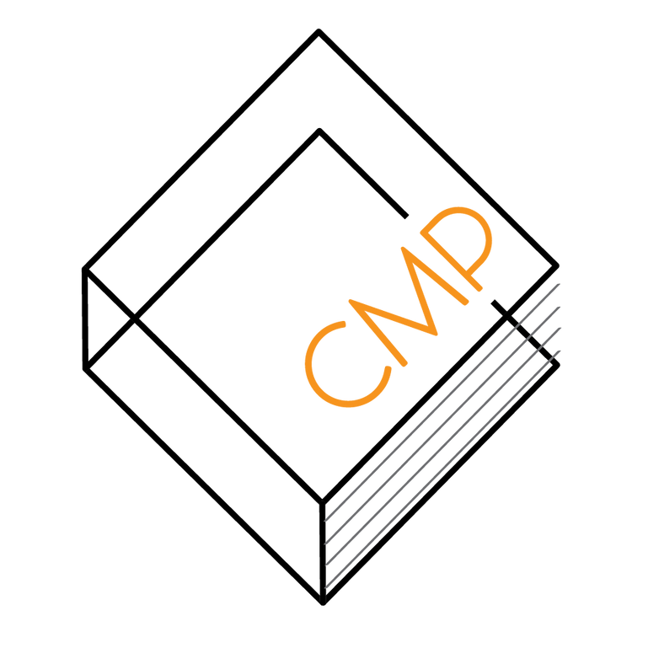
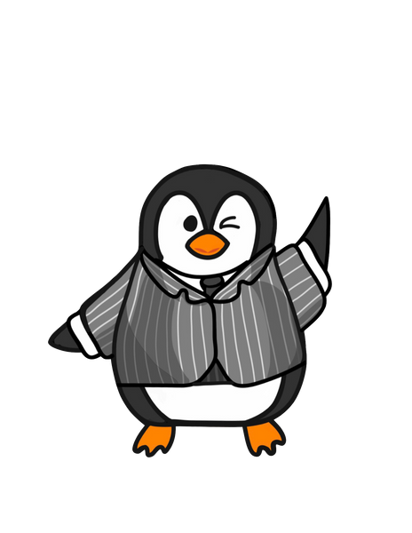
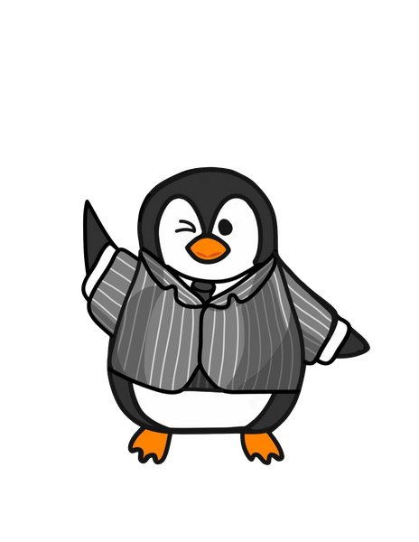

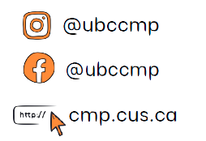

COMMERCE MENTORSHIP PROGRAM
FINAL REVIEW SESSION
COMM 393
Prepared by: Tommy Zhang
Instructed by: Tommy Zhang
Emails: tommyzhang0000@gmail.com

Slide 2
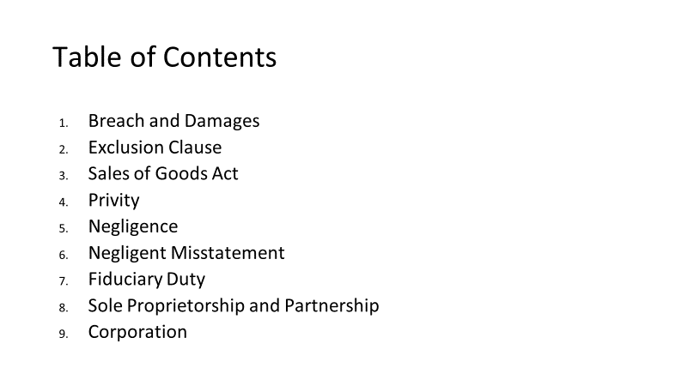

Slide 3
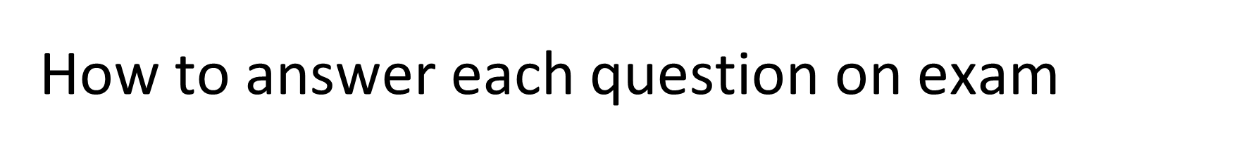
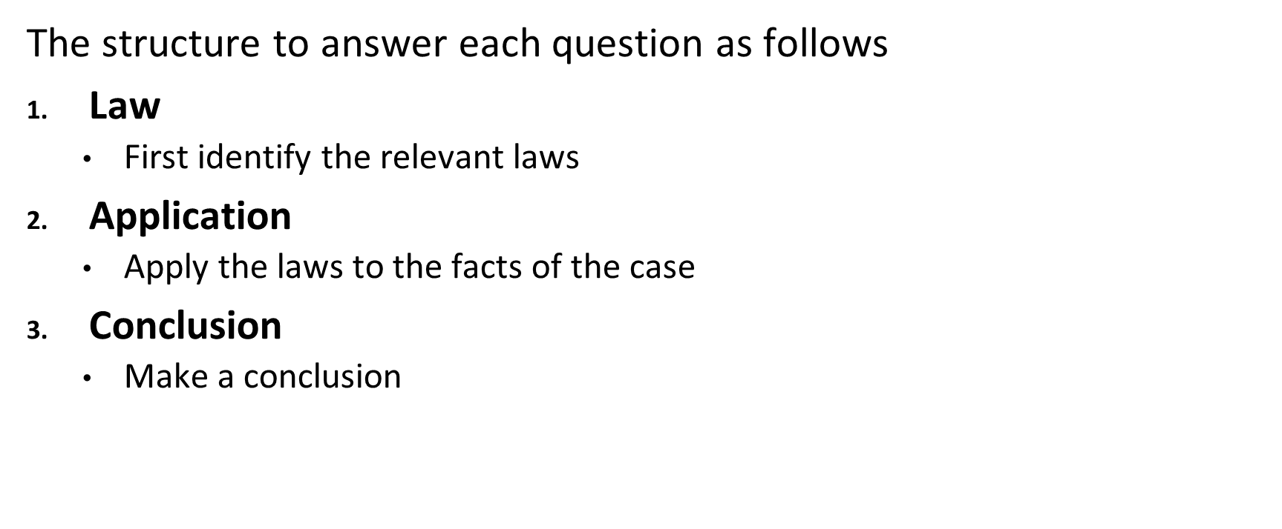

Slide 4
Question (Breach + Damages)
John owns a restaurant and has hired Jim, a professional cleaner, to clean his kitchen before yearly health inspections to avoid fines. The contract signed between the two parties stipulates that "Jim must perform the cleaning services a week before yearly health inspections.”
This year, Jim had been sick the week prior to the inspection and forgot to inform John that he cannot clean his kitchen. At the time of the inspection, John was out of town and trusted that JIm would have cleaned his kitchen based on their contract.
Two days after the inspection, John received a letter from the Canadian Food Inspection Agency due to a unsanitary ventilation system. As a result, John was fined $100k, and the restaurant was closed for 4 months. An enraged John calls Jim for failing to clean his kitchen as agreed. Jim was apologetic for being sick and said he would reimburse John $1,000 for the damages.
An angry John responded by saying: "Are you joking? I have to pay $100k in fines and lost out on 4 months of profits, I’ll see you in court!"
If John decides to sue Jim, would John succeed in his legal action against Jim? What will the extent of damages extend to?
Suppose Jim did perform the service and due to his carelessness, the ventilation system caught fire during the inspection. John claims that since this incident almost "killed" several of his employees, Jim should be liable for punitive damages because there was a breach of contract. Is John right or wrong?

Slide 5
Solution
If John decides to sue Jim, would John succeed in his legal action against Jim? What will the extent of damages extend to?
Law: (Breach + Damages)
Test: Hadley v Baxendale (the defendant did not know the repercussions that followed, house of lords case)
Was there a breach?
Have damages arisen naturally from the breach itself (in the usual course) OR as may reasonably be contemplated by both parties at the time the contract was made, i.e. were the damages reasonably foreseeable
Damages might extend further if special circumstances were made known to the party breaching the contract (tell contractor "I want a specific thing" or “if you don’t clean this kitchen, i will get a huge $100k fine")
Damages should put the injured party in the position it should have been in had the contract been performed. Losses must be mitigated.
Application:
There was a breach of contract; Jim did not perform as was stipulated in the contract.
However, it’s assumed that Jim cannot reasonably foresee that his failure to clean John’s kitchen would lead to $100k in fines and hundreds of thousands in lost profits when he signed the contract. JIm would only be liable for the portion of damages that are reasonably foreseeable if he does not perform his cleaning services.
If John told Jim that his failure to perform the services would lead to $100k in fines and hundreds of thousands in lost profits, then Jim would clearly be liable for those damages since he can now foresee those losses.
Conclusion:
Jim is obliged to compensate John for the losses that he could reasonably foresee John incur as a result of his non-performance. However, Jim is not liable for the consequential damages of the lost profits and the fine if he was not informed.

Slide 6
Solution
B) Suppose Jim performed the services and cleaned his kitchen but carelessly caused the ventilation system to catch fire, almost "killing" several of John’s employees. Would Jim be liable for punitive damages?
The ventilation system catching fire should be deemed a Major Failure (remember the Walmart v Tesla case).
This is not a breach; Jim had fulfilled most of his obligations as stipulated in the contract (cleaning the kitchen). However, his carelessness while performing his duties could have resulted in dire consequences; he is liable for damages.
Punitive damages will only arise when bad faith or malicious behavior is involved. It is assumed that Jim did not purposely cause the ventilation to catch fire in an attempt to hurt John's employees.
Therefore, punitive damages are likely not awarded in this case.

Slide 7
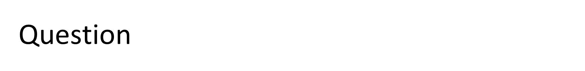
Dean Darren Dahl takes the 393 class on a field trip to Disney"Molan"d, to have some fun before the final. Once they were there, the admissions office, which normally gets all attendees to sign a waiver with an exclusion clause, ran out of paper :(( . As a result, they just let the entire 393 class into the park since there was an exclusion clause on the back of the ticket anyways. It read in bold letters " DisneyMoland" is not responsible for any bodily harm suffered from participating in activities within the park".
There is evidence that Molan, the owner of the park, knew about the frequent breakdowns and dangers of his ride. Yet, he never had his employees tell any attendees.
Questions:
Does the exclusion clause being on the back of a ticket affect its enforceability?
An international student from Wakanda, Tommy, went on one of the rides got severely injured from the entire ride blowing up. There are no theme parks in Wakanda and this is Tommy's first time. Will Tommy be successful in suing Molan's theme park?
Assume that exclusion clauses are binding. Will the ride operators be personally liable?

Slide 8
Answers:
Does the exclusion clause being on the back of a ticket affect its enforceability?
If the park got the students to sign a waiver, it is definitely enforceable because a signature will signify that people have read it.
RELEVANT FOR FINAL: With ticket cases, you must take an extra step to look at whether the business took reasonable steps to bring it to notice. The bold letters likely count by a court. It would be even better if the employees told the attendees about the clause on the back of the ticket. HOWEVER, the ticket might not be enforceable depending on position of plaintiff (greeven v Blackcomb)
An international student from Wakanda, Tommy, went on one of the rides got severely injured from the entire ride blowing up. There are no theme parks in Wakanda and this is Tommy's first time. Will Tommy be successful in suing Molan's themepark?
Law: Maloney V Dockside Test. Normally, you always run maloney for exclusion clause cases.
Does the clause apply? Yes it does, activities within the park includes going on rides.
Is the clause unconscionable?
Yes, Molan had special knowledge that the rides were all dangerous yet told none of the attendees about it. Even if the clause applies, court will strike it down because they would view Molan's attempt to hide the dangers of the park as unconscionable when he knew about it.
Is the clause contrary to public policy?
This applies in cases like murders. It's quite acceptable for a theme park to use exclusion clauses
Law: Position of plaintiff in ticket cases. Greeven V Blackcomb states that "POSITION OF PLAINTIFF MATTERS". In Greeven V blackcomb, a european tourist was able to successfully sue Blackcomb because Greeven was a stranger to the country, never had skied before, and there was no evidence that Greeven was aware of the exclusion clause on the back of the ticket. As a result, exclusion clause doesn't even apply to Tommy as an international student.
Conclusion
Court sides against Molan because of TWO reasons. Firstly, the clause is unconscionable, which fails maloney v Dockside. Secondly, the position of the Plaintiff matters as we've seen in Greeven. Court will also conclude Tommy would not have not known about the clause on the back of the ticket.
Assume that exclusion clauses are binding. Will the ride operators be personally liable?
Answer: no, principle exception to privity.

Slide 9
Question (SGA)
After making $2,000,000 upon selling his company, Nalom went to buy himself an exotic car at Mot’s dealership. After asking Mot which car has the best acceleration, Mot recommended the new Enzo Model. Nalom decided against Mot’s recommendation and decided to purchase a classic Porsche 911 instead. Though disappointed that Nalom did not buy the automobile he recommended, Mot was happy to see his client find a car he liked. Before Nalom left, Mot told him, “It seems you didn’t rely on my professional expertise; but this is a great choice too! The 911 has always been known to have good acceleration!"
After driving the car for a couple of days, Nalom felt he had made a mistake in purchasing the 911. He complained to his friends about the car's engine and the lack of acceleration. Nalom was unsure whether he could return the vehicle.
Can Nalom return the car? Explain the legal basis for your conclusions.

Slide 10
Solution:
Can Nalom return the car? Explain the legal basis for your conclusions.
Law:
Purpose of SGA:
The SGA applies where there is a sale of goods from a dealer (where they sell the good in the ordinary course of their business) to a customer. In this case, Mot is in the business of selling cars (a good) and Nalom bought the cars with cash, so the SGA will apply, including the “implied terms of the SGA”. If an implied term is breached, Nalom would be able to return the goods (rescission). However, given the below analysis, it is not likely that Nalom will be able to return the goods.
The 3 part test for Section 18(a): Warranty or Condition re Quality or Fitness for Particular Purpose:
The implied terms of the SGA state that goods must be fit for their purpose if:
the buyer communicates the purpose for the goods to the seller ;
so as to show that the buyer is relying on the seller’s skill and judgment ;
and it is in the usual course of the seller’s business to supply those goods (Kobelt); and
the goods were not purchased using a trade or patent name
Apply:
In this case, it would appear that Nalom bought the 911 (car) at his discretion despite Mot recommending a different car. Though the first criteria had been met (Nalom told Mot he wanted a vehicle with good acceleration), he did not rely on Mot's skill and judgment (he bought a 911 instead of an Enzo). Further, it appears that he purchased the vehicle by providing the model number of the car (akin to a trade name), thus failing the requirements of this section.
Conclusion:
Nalom is likely unable to return the car.

Slide 11
Privity (Question)
Zhang development is building a new apartment in Wesbrook. Zhang development hires a contractor (imperial constructions) to build the apartment. The contractor also contracted the world-famous architect Molan Liu as a subcontractor. Because of Molan's poor work ethic (terrible!), he was unable to get the plan for the building done. The project missed many deadlines and costs were greatly increased by $100k. Zhang development sues Molan but Molan remembers the 393 class he took with Elicia! Molan says to himself: 'heh heh heh, they can't sue me in contract, I'm safe!".
Questions:
Why does Molan think he cannot be sued in contract? Is he right?
Assume that Molan was not a subcontractor and was an employee under the contractor (Imperial Construction). Also, assume that there is a totally legal enforceable exclusion clause that states "Imperial constructions will not be liable for any damages caused by delays in the construction process". Will Zhang dev be able to sue Molan?

Slide 12
Why does Molan think he cannot be sued in contract? Is he right?
Law: Under privity, only parties to a contract can enforce the contract or have the contract enforced on them because the parties provided consideration
Application: Molan thinks that Zhang dev cannot sue him because they do not have privity. He is right only in that Zhang dev cannot sue him through privity since they do not have a direct contract together. However, he forgot that Zhang dev can sue him under tort.
Law: Under tort, parties can be sued even if they were not in a contract with the plaintiff if it is proven that there was culpability (duty of care was not met through unjustifiable behaviour) and causation (some type of harm resulted).
Application: Zhang Dev can sue Molan under tort and prove:
Culpability: Molan breached the duty of care through careless disregard because of laziness and poor work ethic
Causation: Molan caused $100k in damages to Zhang dev.
Conclusion: Zhang dev will be able to sue Molan under tort and win.

Slide 13
2. Assume that Molan was not a subcontractor and was an employee under the contractor (Imperial Construction). Also, assume that there is a totally legal enforceable exclusion clause that states "Imperial constructions will not be liable for any damages caused by delays in the construction process". Will Zhang dev be able to sue Molan?
Law: Principled exception to privity: DESCRIBE PRIVITY FIRST. An exclusion clause written by the business extends to the employee even if the clause was originally between the business and customer
The limitation clause extends to employees if the original parties intended to extend it to them
The employees must have been performing services on behalf of the employer and is acting within the scope of their job
Law: vicarious liability: the employer is liable for damages caused by mistakes committed by employee within scope of employment
Application: Because of the principled exception to privity, Zhang dev cannot sue Molan. The exclusion clause extends to Molan.
Application: Zhang Dev also cannot sue Molan personally because vicarious liability states that the employer (Imperial) would be liable for all damages caused by employees. Molan was acting within the scope of employment as an architect. (not being within scope would be if Molan crashed a lambo on a race track, which is totally unrelated to what he was employed to do at Imperial)
Conclusion: Zhang Dev cannot sue Molan personally because of vicarious liability and exclusion clause. Zhang dev would also not be successful in suing Imperial because of the exclusion clause.

Slide 14
Question (Negligence)
Samantha went to a popular restaurant in town to meet her friends for lunch. It was a rainy day, and the restaurant floor was wet. Unfortunately, the restaurant did not have a wet floor sign displayed. As Samantha walked towards the table, she slipped on the wet floor and fell, fracturing her hip. Samantha decides to sue the restaurant for negligence. The restaurant argues that Samantha is partially to blame for not noticing the wet floor.
Assess the legal rights and liabilities of Samantha and the restaurant in this situation.
Does Samantha have a case against the restaurant?
What if Samantha was excitedly running around the restaurant when she slipped?

Slide 15
Answer (Negligence)
Assess the legal rights and liabilities of Samantha and the restaurant in this situation. Does Samantha have a case against the restaurant? How might contributory negligence apply in this case?
Answer:
Law: Negligence test
Application: The negligence test involves four elements: duty of care, breach of duty, causation, and damages.
Duty of Care: The restaurant owes a duty of care to its customers to provide a reasonably safe environment. This includes taking reasonable steps to ensure that customers are not exposed to foreseeable risks of harm, such as slipping on a wet floor.
Foreseeability and Proximity: it’s quite foreseeable that a restaurant’s wet floor can cause damage to customers. The relationship between restaurant and customer is also quite proximate (close)
Indiscriminate liability does not apply here. Duty of care would not be extended too broad if restaurant is liable.
Breach of Duty: The failure to put up a sign warning customers of the wet floor could be a breach of the restaurant's duty of care.
Causation: The absence of a warning sign could be the cause of the customer slipping and falling. We can look to standard practice in the industry, which is to have a caution sign when there is a wet floor. Also, it’s required by standards in the restaurant industry as well.
Damages: The customer breaking their back could be considered as damages resulting from the fall.
Conclusion: The restaurant could be liable for negligence in this situation.
What if Samantha was excitedly running around the restaurant when she slipped?
Contributory negligence would apply in this situation. If Samantha was running around the restaurant or not exercising reasonable care in avoiding the wet floor, they may be found to have contributed to their own injury. This could result in a reduction of the damages awarded to the customer in proportion to their degree of fault.

Slide 16
Question (Negligent Misstatement)
Tommy's Pizzeria hired Molan Liu, a CPA, to prepare a set of financial statements for his pizzeria so that he can evaluate the performance and assets of his business, to determine a value for his business. Tommy was surprised at how good the numbers were and so sold off the business for $3 million to Jimmy. Unfortunately, the reason why numbers were so good was because Molan slept through his 293 and 353 classes, and accidentally inflated the profits and assets of the business by 40%.
Jimmy sues Tommy for falsely inflating the value of his business.
Can Tommy sue Molan?
Can Jimmy sue Molan directly?
Assume that Tommy told Molan that the financial statements will be used by Jimmy to evaluate the value of his pizzeria to buy it in the next month. Can Jimmy sue Molan now?
Assume that Tommy sold Jimmy the business through Tommy Holdings Inc. Tommy owns 100% of the shares. Describe the potential consequences for Tommy if Jimmy sues Tommy holdings.

Slide 17
Solution: Can Tommy sue Molan?
Run through negligent misstatement test.
Law
Duty of care
breach of standard of care
injury to plaintiff
causation of damage
Application:
Duty of care. Foreseeability and proximity. It is foreseeable that inflating the assets of a business would cause it to be overvalued. Tommy stated that he wants to determine the value of his business.
The standard of care: it's expected that Molan should be able to prepare a financial statement that is not inflated by 40% as a CPA. A competent accountant would not inflate it by 40%
There was an injury sustained because Tommy is now being sued for overvaluing his business.
Causation. But for test: if it wasn't for Molan, Tommy would not have overvalued his business.
Conclusion: Yes, Tommy can sue Molan.

Slide 18
Solution: Can Jimmy sue Molan directly?
Run through negligent misstatement test again. Conclusion is no because of indeterminate liability, which means there is no duty of care to Jimmy.
Run through negligent misstatement test.
Law
Duty of care
breach of standard of care
injury to plaintiff
causation of damage
Application:
Duty of care. Foreseeability and proximity.
INDETERMINATE LIABILITY: in this case, Tommy never mentioned that Jimmy would use the statements to buy the business to Molan. Rangen V Deloitte: Tommy needs to mention WHO, WHEN, and “FOR WHAT PURPOSE” the statements are going to be used for to extend duty of care to Jimmy
NO, duty of care does not extend to JImmy
The standard of care: it's expected that Molan should be able to prepare a financial statement that is not inflated by 40% as a CPA.
There was an injury sustained because Tommy is now being sued for overvaluing his business.
Causation. But for test: if it wasn't for Molan, Tommy would not have overvalued his business.
Conclusion: No, Jimmy cannot sue Molan

Slide 19
Solution: Assume that Tommy told Molan that the financial statements will be used by Jimmy to evaluate the value of his pizzeria for an acquisition next month. Can Jimmy sue Molan now?
Run through negligent misstatement test. Conclusion is yes because Tommy told Molan exactly what purpose the statements will be used for, which means there IS a duty of care to Jimmy now.

Slide 20
Solution: Assume that Tommy sold Jimmy the business through Tommy Holdings Inc. Tommy owns 100% of the shares. Describe the potential consequences for Tommy if Jimmy sues Tommy holdings.
As a shareholder, Tommy will only be able liable for the full amount that he invested into the business. However, the corporation itself can hypothetically lose all of its assets.

Slide 21
Question
Taking advantage of governmental stimulus cheques and the overwhelmingly bullish market, managers and executives of Sneakbrokrs decided to launch an IPO during the height of the pandemic. However, because of the market environment and people's general disinterest in sneakers, Sneakbrokrs went bankrupt after a year in operation. Having lost millions of dollars investing in Sneakbrokrs' shares, Sneakbrokrs' shareholders sued Sneakbrokrs for a breach of fiduciary duty.
Does sneakbrokrs have a fiduciary duty to shareholders?
Will the shareholders be successful?

Slide 22
Does sneakbrokrs have a fiduciary duty to shareholders?
Law: Fiduciary Duty test: (Alberta v Elder Advocates of Alberta Society) (fulfill all 3
Establishing a fiduciary duty
To establish whether a fiduciary duty exists, there are three steps as outlined by the SCC in Alberta v Elder Advocates of Alberta Society quoted in Strothers
The professional or fiduciary has undertaken to act in the best interests of the beneficiary
The beneficiary is vulnerable to the fiduciary's control or discretion
An interest (legal or practical) could be harmed by the fiduciary's exercise of discretion or control (has something at risk)
Apply
The professional or fiduciary has undertaken to act in the best interests of the beneficiary
Managers of corporations are legally required to act in the interest of their shareholders
The beneficiary is vulnerable to the fiduciary's control or discretion
Shareholders do not make the day-to-day decisions at companies. They leave all decisions up to the managers, which means the managers exercise decision making power that leaves shareholders vulnerable.
An interest (legal or practical) could be harmed by the fiduciary's exercise of discretion or control (has something at risk)
Yes, shareholders can lose value on their investments
Conclusion: yes, there is a fiduciary duty.

Slide 23
2. Will the shareholders be successful?
Law: Business Judgement rule- this rule assumes that these individuals act in good faith, with due diligence, and in the best interests of the corporation when making business decisions. Even an outcome from a decision was negative for shareholders, as long as directors demonstrate that they acted in the best interests of the corporation, they have not broken the business judgement rule or breached their fiduciary duty
Sneakbrokrs need to show that they have acted 1) honestly and in good faith with a view to the best interests of the company/other party and 2) exercised the care, diligence and skill that a reasonably prudent individual would exercise in comparable circumstances, 3) considered the interests of a range of stakeholders. s long as Sneakbrokrs makes it clear that they have done their due diligence and considered the interests of everyone, they will not be liable.
Application:Sneakbrokrs has shown that they did their due diligence before launching the IPO and considered the shareholders' interests. Judging by the macro-environment at the time, it can be presumed that Sneakbrokrs believed its investors would be able to obtain a healthy rate of return at year's end. However, factors outside of Sneakbrokrs' control (i.e. rate hikes, Fed's hawkishness etc) has prevented Sneakbrokrs from obtaining the resources (sufficient funding etc.) they need; shareholders lost money as a result (students could write this down for clarity; this helps articulate why Sneakbrokrs is not liable and can help reinforce the BJR).
Conclusion: Even though the outcome was negative, Sneakbrokrs made a decision that did not break the business judgement rule and did not breach their fiduciary duty. Thus, they are not liable for the wrongful outcome of the decision. The court will rule against the shareholders in the lawsuit.

Slide 24
Questions (Partnerships)
Beanz, Bunz, and Borz are three friends who decided to start a consulting company called 3B Partnerships. In the agreement, the 3 B's decided to split their profits equally 3 ways, and each will hold a management position in the firm. Borz has been in a medically induced coma for the last four years; during his absence, 3B has been operated on by the other two founding members. No notice of termination was given to Borz during his time in a medically induced coma. After awakening from his coma, Borz discovered that 3 B's has expanded to Vancouver's largest consulting firm with offices across 20 locations. However, Borz was not entitled to any profits as Beanz and Bunz argued that he had not been involved in revenue generation. Dejected upon hearing the news, Borz felt indignant, as he had invested a lot during the early stages of the company. As a result, he decided to sue Beanz and Bunz for ⅓ of the profits 3 B's made over the last four years.
Presuming that no express agreement was made to expel Borz during the time he was in a medically induced coma, would Borz be successful in his lawsuit against the two B’s (Beanz and Bunz)?
Assume that Beanz had been found liable for breaching fiduciary duties and was ordered by the court to compensate his client 40 million dollars. Beanz did not have enough money to pay back the claimant; in this case, could the claimant look to Borz and Bunz to indemnify their losses?

Slide 25
Answers (Partnerships)
Presuming that no express agreement was made to expel Borz during the time he was in a medically induced coma, would Borz be successful in his lawsuit against the two B’s (Beanz and Bunz)?
Law: Termination of Partnership
generally should be express provision for what triggered termination: notice, retiring partner etc.
Partnership act has default rules in case not provided or:
if there is no fixed term of partnership can be a termination by notice from a partner
automatic termination on the death of a partner
Law: how are the criteria of partnership fulfilled?
Carrying on business:
Commercial purpose, continuous
Isolated business transactions where people are acting with shared interests are not necessarily partnerships; need to be continuing and on a regular basis.
In common:
It has to be a consensual relationship (a sense of dependency on each other and to do things together where both are willing to be in partnerships (evidence)
Typically written but could be oral etc., depending on the conduct of parties (courts will look at substance) -> one party, a manager etc.
and requires intension
With a view to profit
Sharing of profits is essential.
Sharing of gross receipts is not enough (usually, people within a partnership have to contribute to expenses to fit within “with a view to profit)
more laws for carrying on business in common: liability of debts, role in management needed

Slide 26
Answers (Partnerships)
Apply: Given that the 3B’s decided to team up and start a company, it is assumed that their business relationship is continuing and on a regular basis. In addition, it has been stated that the three members of 3B’s were originally each promised an ownership share as well as a management position in the firm; it is evident that there was an intention to form this partnership with a view to profit. Partnership criteria have been fulfilled. 3B‘s is a general partnership, as no paperwork was filed to declare the firm as an LLP or LP.
Conclusion: There was no notice of termination when Borz was in a medically induced coma; as a result, Borz was still a partner in the company and therefore was entitled to the profits. Borz should be able to succeed in his lawsuit against the other 2 Bs (Beanz and Bunz).

Slide 27
Answers (Partnerships)
b) Assume that Beanz had been found liable for breaching fiduciary duties and was ordered by the court to compensate his client 40 million dollars. Beanz did not have enough money to pay back the claimant; in this case, could the claimant look to Borz and Bunz to indemnify their losses?
In a general partnership, all members are personally liable for the debts and liabilities of the partnership. In this case, Borz and Bunz would have to indemnify the claimant for their losses.

Slide 28
Corporations (Questions)
Molan and Tommy start a Chinese restaurant together to compete with Grand Noodle Emporium and Sesame. They both participate in meetings and contribute 50% of the initial cash to start up the company. They also took out loans from their parents and rich friends at Sauder. Unfortunately, their food tasted so bad that students would often be rushed to the UBC Hospital. They likely won't be able to make payments on their debts because they soon expect their business to go bankrupt
What kind of partners are Molan and Tommy?
What can Molan do if his parents sue him personally?

Slide 29
Corporations
What kind of partners are Molan and Tommy?
Answer
General partnership:
They are both carrying on in business in this restaurant and are both participating in management
Both are fully personally liable for all of the business's debts
They both contributed capital

Slide 30
Corporations
What can Molan do if his parents sue him personally?
Molan can look to Tommy for indemnification because all partners all liable for the actions taken by the other partners on behalf of the business
Even if Molan took out the contract, the contract is binding on all other partners in the GP.

Slide 31
Corporations
Because they took 393, Molan and Tommy remembered that they can simply turn their business into a corporation and can minimize the lawsuits that they anticipate will come (yay, so smart!). Molan and Tommy registered as T&M Inc.
Describe the process that Molan and Tommy took to incorporate
Will they be successful in their incorporation attempt?
Why does Molan and Tommy believe they can minimize their losses through incorporation?

Slide 32
Corporations
Describe the process that Molan and Tommy took to incorporate
Incorporation is done through the (Canadian business corporation act) or provincially under provincial act
The process requires constating documents (share capital, hq, name etc)
b) Will they be successful in their incorporation attempt?
Answer
Salomon case: Corporate veil will be lifted under intention to deceive.
Companies that go from unlimited liability to corporation must let their suppliers or creditors know of the change in status of else will be sued under unlimited liability
Because Tommy and Molan incorporated to escape their debts without telling their creditors, the courts will lift the corporate veil and they will still be personally liable for the debts.

Slide 33
Corporations
c) Why does Molan and Tommy believe they can minimize their losses through incorporation?
Answer
As shareholders of a corporation, Tommy and Molan will only be able liable for the full amount that they invested into the business. Tommy and Molan's creditors would not be able to seize their personal assets if the business was a corporation. However, the corporation itself can hypothetically lose all of its assets.

Slide 34
Corporations
Assume that the restaurant is now incorporated and Tommy and Molan are directors. Molan supposedly went looking for new suppliers of ingredients for the restaurant. However, he actually went to the cheapest supplier in town and took a 10% commission on whatever he charged. Tommy found out and sued Molan, will Tommy be successful?

Slide 35
Corporations
Answer
Law: if fiduciary duty is breached due to conflict of interest, corporation can receive disgorgement from a director
profit or commission obtained as a result of position of directorship is the property of the company (disgorgement)
Secret commission constitutes a breach of fiduciary duty
The contract entered into is voidable since there was a conflicting interest
The contract cannot be ratified (consent) unless ratification occurs with full knowledge of the material facts (company must know everything regarding the deal, they must know about the mark-up)
Apply:
company entitled to disgorgement/restitution. Given the breach of fiduciary duties, the company is entitled to disgorgement (breach of the duty of care)
Charging a secret commission is deceit
Molan had a conflict of interest.
Tommy did not know about the secret commission that Molan took.
Conclusion: Not only will this contract with the supplier be void, the restaurant is entitled to the entire amount they paid, plus the commission that Molan took, which Molan must pay for himself.

